Slide 1
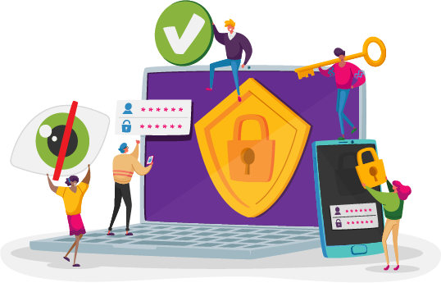
Secure the Network

Slide 2
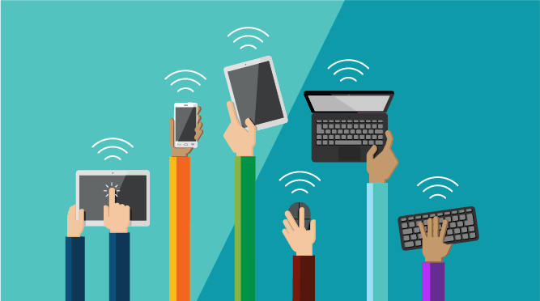
What do you use the internet for?
Notes:
Instructor Notes:
Click once and ask students to share answers to: What do you use the internet for?
Encourage students to turn to a partner and brainstorm as many different ways that they use the internet as they can in one minute.
Regain the class’s attention when one minute is complete.

Slide 3
Digital Footprint
Data left behind can include: Name, email address, location, personal devices used, advertisements clicked, songs downloaded, pictures posted, websites visited, credit card numbers, bank account information, mailing address, phone number… and more!
Notes:
Instructional Notes:
Tell the class that every time someone uses the internet, they leave behind a trail of personal data or information.
Explain that this trail of data is called their digital footprint.
Click twice and read through the sample list of data that someone can leave behind on the internet.
Then ask students: Why could it be dangerous to leave this data behind?
Explain that:
Hackers are cybercriminals who try to break into websites and networks and steal personal data. They then give this information to other cybercriminals who can use it in all kinds of ways.
While sharing this data can make our lives easier (for instance, we can have packages delivered to our doors!), we also have to make sure that our data is only used by the people who are supposed to have it.

Slide 4
Create a Company
Notes:
Instructional Notes:
Divide students into pairs and explain that each pair will now think about the importance of protecting personal data from the perspective of a company.
Distribute one Create a Company handout to each pair and review the directions provided.
Give students about 10 minutes to collaborate and complete each of the steps.
Then bring the class back together and discuss students’ responses to the handout’s third question.

Slide 5
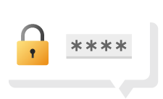
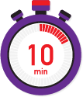
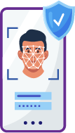
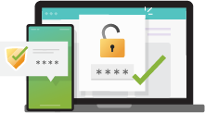
Security Stations
All About Ciphers
Create A Password
Dual-Factor Verification
Biometrics
Notes:
Instructional Notes:
Reiterate that internet security is important because it keeps personal information safe and protects it from cybercriminals who may try to use it in bad ways.
Tell the class that they will be working in stations to investigate this idea of internet security for the rest of the class session.
Preview that the stations will explore the topics of ciphers, passwords, dual factor verification, and biometrics. Then show students where they can find the four stations located around the classroom.
Prepare students for their station activities by performing the following:
Assign each group a starting point. Explain that you will be giving timing reminders to keep them on track. Students can rotate clockwise to the next station each time they finish the activity.
Pass out one Capture Sheet handout to each student and explain that each square corresponds with one station.
Explain that student pairs should carefully read the directions at each station in order to complete the activity. The final step will always be to record information on their Capture Sheet.
Then encourage students to go to their first station and begin!
Click the timer to begin the countdown. Every 10-15 minutes, encourage students to move on to the next station if they haven’t already.
As students finish all four stations, give them a Session 1: Conclusions handout (one half-sheet per student). They may work on this until there are about 5 minutes left in the class session and/or the rest of the class is also done with their station work.

Slide 6
Make Conclusions
Many websites are still protected by only a username and password.
Based on what you have learned, how could these websites strengthen their security?
Notes:
Instructional Notes:
When there are at least five minutes left in the class session, regroup as a class.
Click to display the question presented on the Session 1: Conclusions handout and read it aloud.
Based on the time left in the session, either discuss this question as a class or assign students to jot their ideas on the handout for homework.

Slide 7
Intruder Protection
Notes:
Instructional Notes:
Bring students’ attention to the castle image on the slide.
Ask them to imagine that the castle represents the business they brainstormed last session. Inside the castle rests all the personal information that their business has collected from customers.
Click once to add a moat, bridge, and guard to the image.
Encourage students to pretend that this entry point represents how someone logs in into their business’s website.
Then ask: Would you say that this entryway represents a safe and secure login or an unsafe login? Why?
Help students understand that this image represents an unsafe login. Any website with only one guard and entry point (such as a password) is not as safe and secure as it could be.
Ask students to think/pair/share: How could this castle be made safer and more secure against intruders?

Slide 8
Zero Trust Architecture
A security system designed with the belief that no one can be trusted. The user’s identity must be verified every time information is accessed.
Notes:
Instructional Notes:
Tell the class that a more secure way to access a website and navigate within it is called zero trust architecture. Explain that architecture is the design of how something is built.
Click and explain that in zero trust architecture, no one is trusted at the entry point—even if the guard recognizes you! There is always a security check.
Then click to show the image of the castle, this time with guards in many different areas.
Explain that with zero trust architecture, all important pieces of information are protected separately. Even once someone is inside, they must pass through a security checkpoint every time they want to access a new piece of important information.

Slide 9
Zero Trust Architecture
Advantages | Disadvantages
Notes:
Instructional Notes:
Ask: What may be the advantages and disadvantages of zero trust architecture?
Encourage students to help you fill out the T-Chart.
Be sure students understand that:
Disadvantages may include that it takes longer to log in and/or for people who work at the company to access information.
Advantages include that it is harder for someone to break into the website and if the website is hacked, all of the data is not immediately at risk!

Slide 10
Multi-factor Verification…
confirms the user’s identity based on:
Something you know…
Something you have…
Something you are…
Password
Username
PIN
ID number
Smartphone
QR code
USB
Your biometrics
Notes:
Instructional Notes:
In addition to having multiple security checkpoints, explain that these checkpoints could also use dual- or multi-factor verification.
Ask: Based on what you learned about dual-factor verification, what do you think multi-factor verification is?
Click the title and explain that multi-factor verification is one step up from dual-factor verification. In multi-factor verification, the user’s identity is verified using three main categories: something you know, something you have, and something you are.
Ask for student ideas about what each category may include before you click the title to show and read the examples.
Tell students that just as dual-factor verification is stronger than a system that uses a single step for logging in, adding this third step can make the login even more secure and harder to crack!

Slide 11
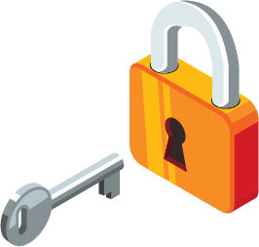
Website Security
Who are the two main groups that will have to access your company’s website?
Customers
Employee(s)
Notes:
Instructional Notes:
Tell students that for the rest of the class session, they will be challenged to apply what they have learned as they think through the security of their new company’s website.
Click and ask: Who are the two main groups who will have to access your website?
Click again and help students understand that there are two different entry points that will need to be protected:
How the customer logs in, gives their personal information, and purchases an item or service
How someone who works at your company logs in and accesses the customers’ information

Slide 12
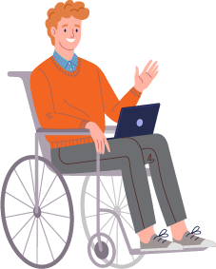
How will you protect your website?
Create a map that illustrates how a customer and employee(s) would use your website.
Be sure to apply what you have learned to make your new business’s website as safe and secure as possible.
Customer Log In Steps:
Company Log In Steps:
Company Access:
What will members of the company have to do to access the information that the visitor gives (such as their credit card info, address, etc.?):
Online Purchase: Describe the steps a customer must take to make a purchase and where the security checkpoint will exist!
Notes:
Instructional Notes:
Prepare students for the activity by performing the following:
Ask students to take out their completed Create a Company and Capture Sheet handouts from Session 1.
Distribute one Security Map handout to each pair and review the steps together.
Remind students that their goal is to create a website that is as secure as possible. Encourage them to think about the topics they have learned about, as well as the information recorded on their Create a Company and Capture Sheet handouts.
Optional: For students who may need additional guidance, click twice to display a sample security map and review it together. Explain that pairs may use this map as a model as they create their own.
Distribute one posterboard or large piece of paper to each pair, and show students where they can find the scissors, glue, and coloring supplies.
Then encourage pairs to begin!

Slide 13
Pair – Share – Suggest
What is one way that your peers could make their security map even stronger?
Notes:
Instructional Notes:
When there are 10-15 minutes left in the class session, encourage pairs to share their maps with another group and explain the security measures that a customer and a member of the company would face.
Challenge each pair to suggest one additional way that their peers could strengthen their security map.

Slide 14
Reflection
How can you apply the concepts you have learned over these two class sessions to help your personal data stay safe online?
Notes:
Instructional Notes:
Conclude with a full-class discussion around the question presented on the slide: How can you apply the concepts you have learned over these two class sessions to help your personal data stay safe online?

