Slide 1




All Things Digital

Slide 2

What is Technology?
Time's Up!
0:01
0:02
0:03
0:04
0:05
0:06
0:07
0:08
0:09
0:10
0:11
0:12
0:13
0:14
0:15
0:16
0:17
0:18
0:19
0:20
0:21
0:22
0:23
0:24
0:25
0:26
0:27
0:28
0:29
0:30
Snowball fight!
30 Seconds
Start Timer
Notes:
Instructor Notes:
As you distribute sticky notes, direct students’ attention to the question at the top of the slide: “What is technology?”
Click to reveal the “snowball fight” screen. Tell them that when you say “go,” you will start the 30-second timer. They will have 30 seconds to write their answers to that question on their sticky notes, crumple them up, and throw them towards you in the front of the room.
Click to start the timer.
When the timer sounds, collect the “snowballs” and begin reading them, as many as time allows.

Slide 3
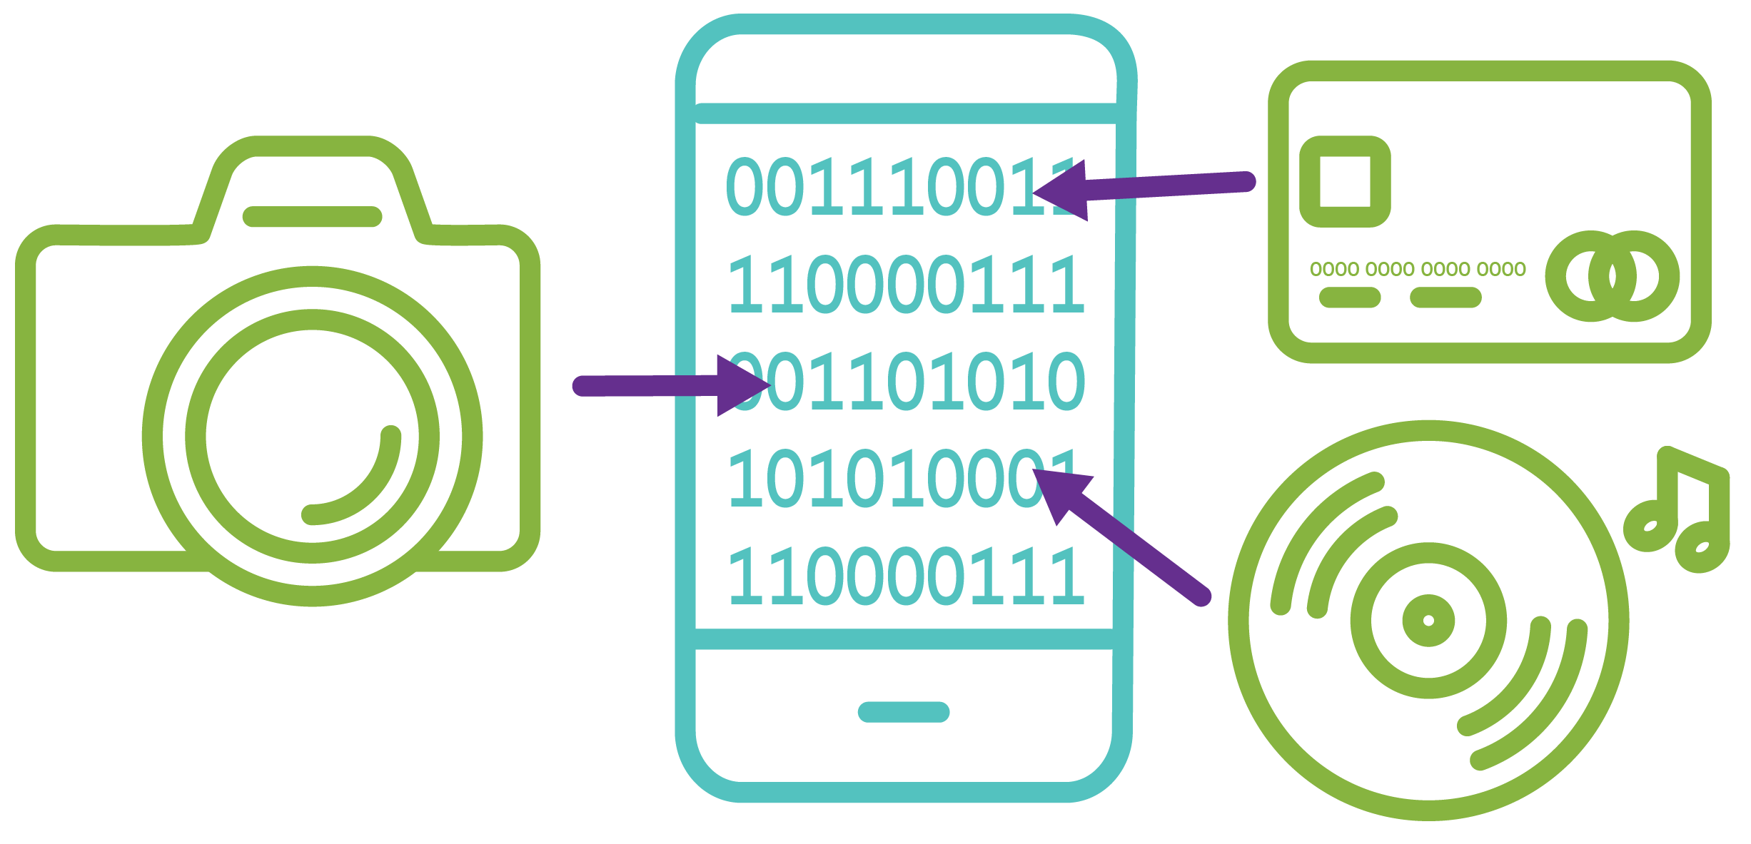
Technology
The use of science to invent useful things or solve problems
Any application of knowledge toward a practical purpose
Notes:
Instructional Notes:
Reveal the definition of technology: the use of science to invent useful things or solve problems; any application of knowledge toward a practical purpose.
As a class, discuss whether any of the “snowballs” came close to the definition. Acknowledge if any were examples of technology.

Slide 4





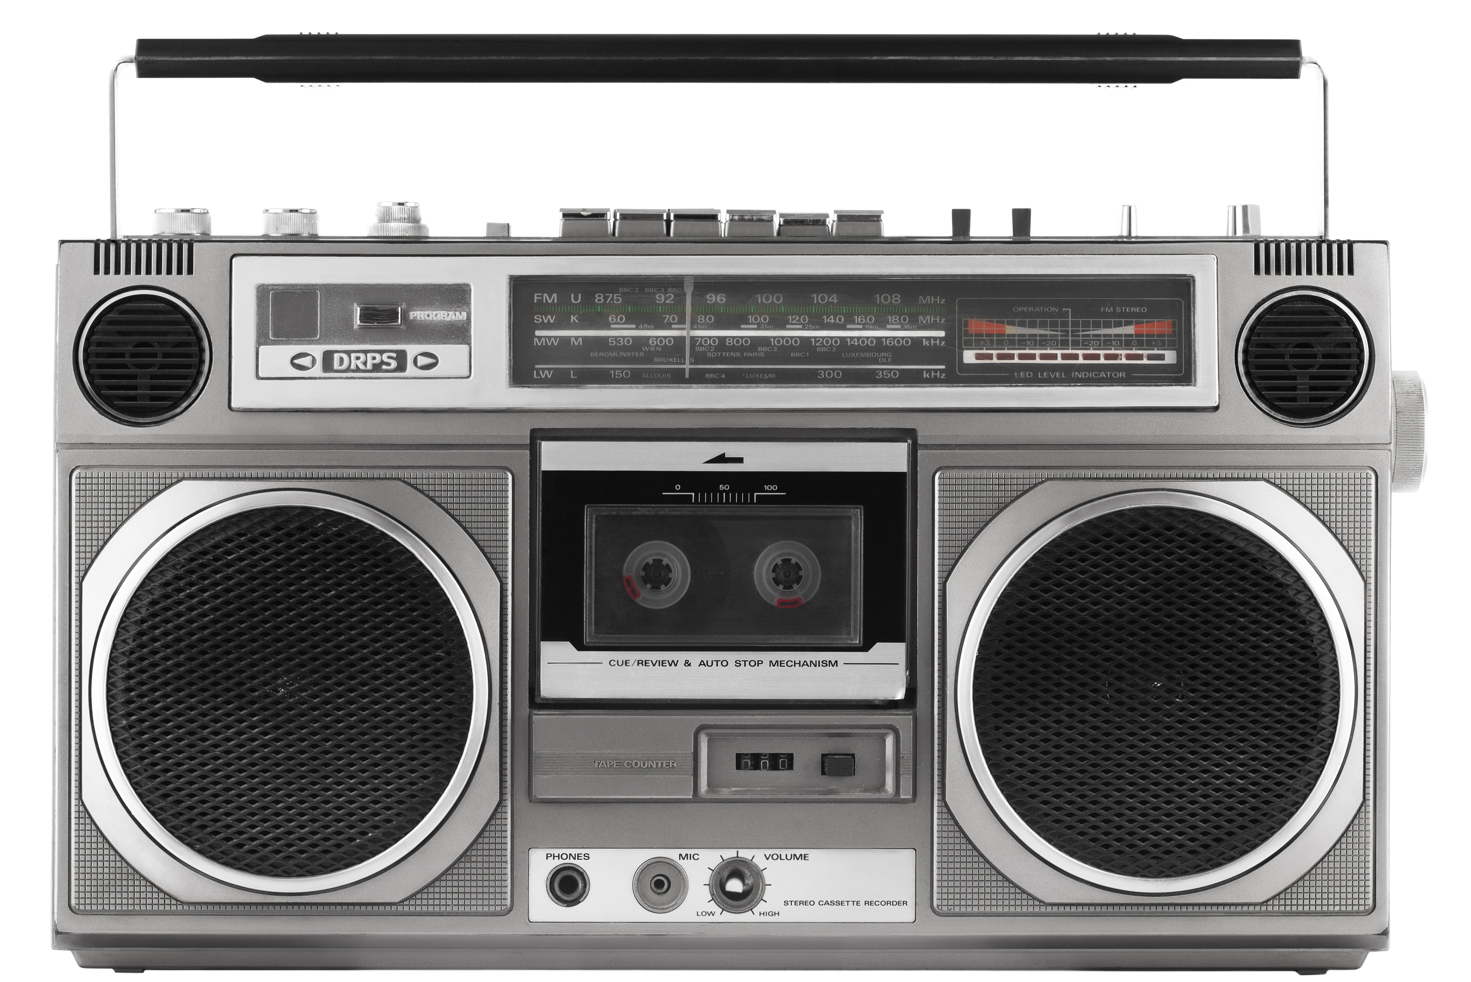


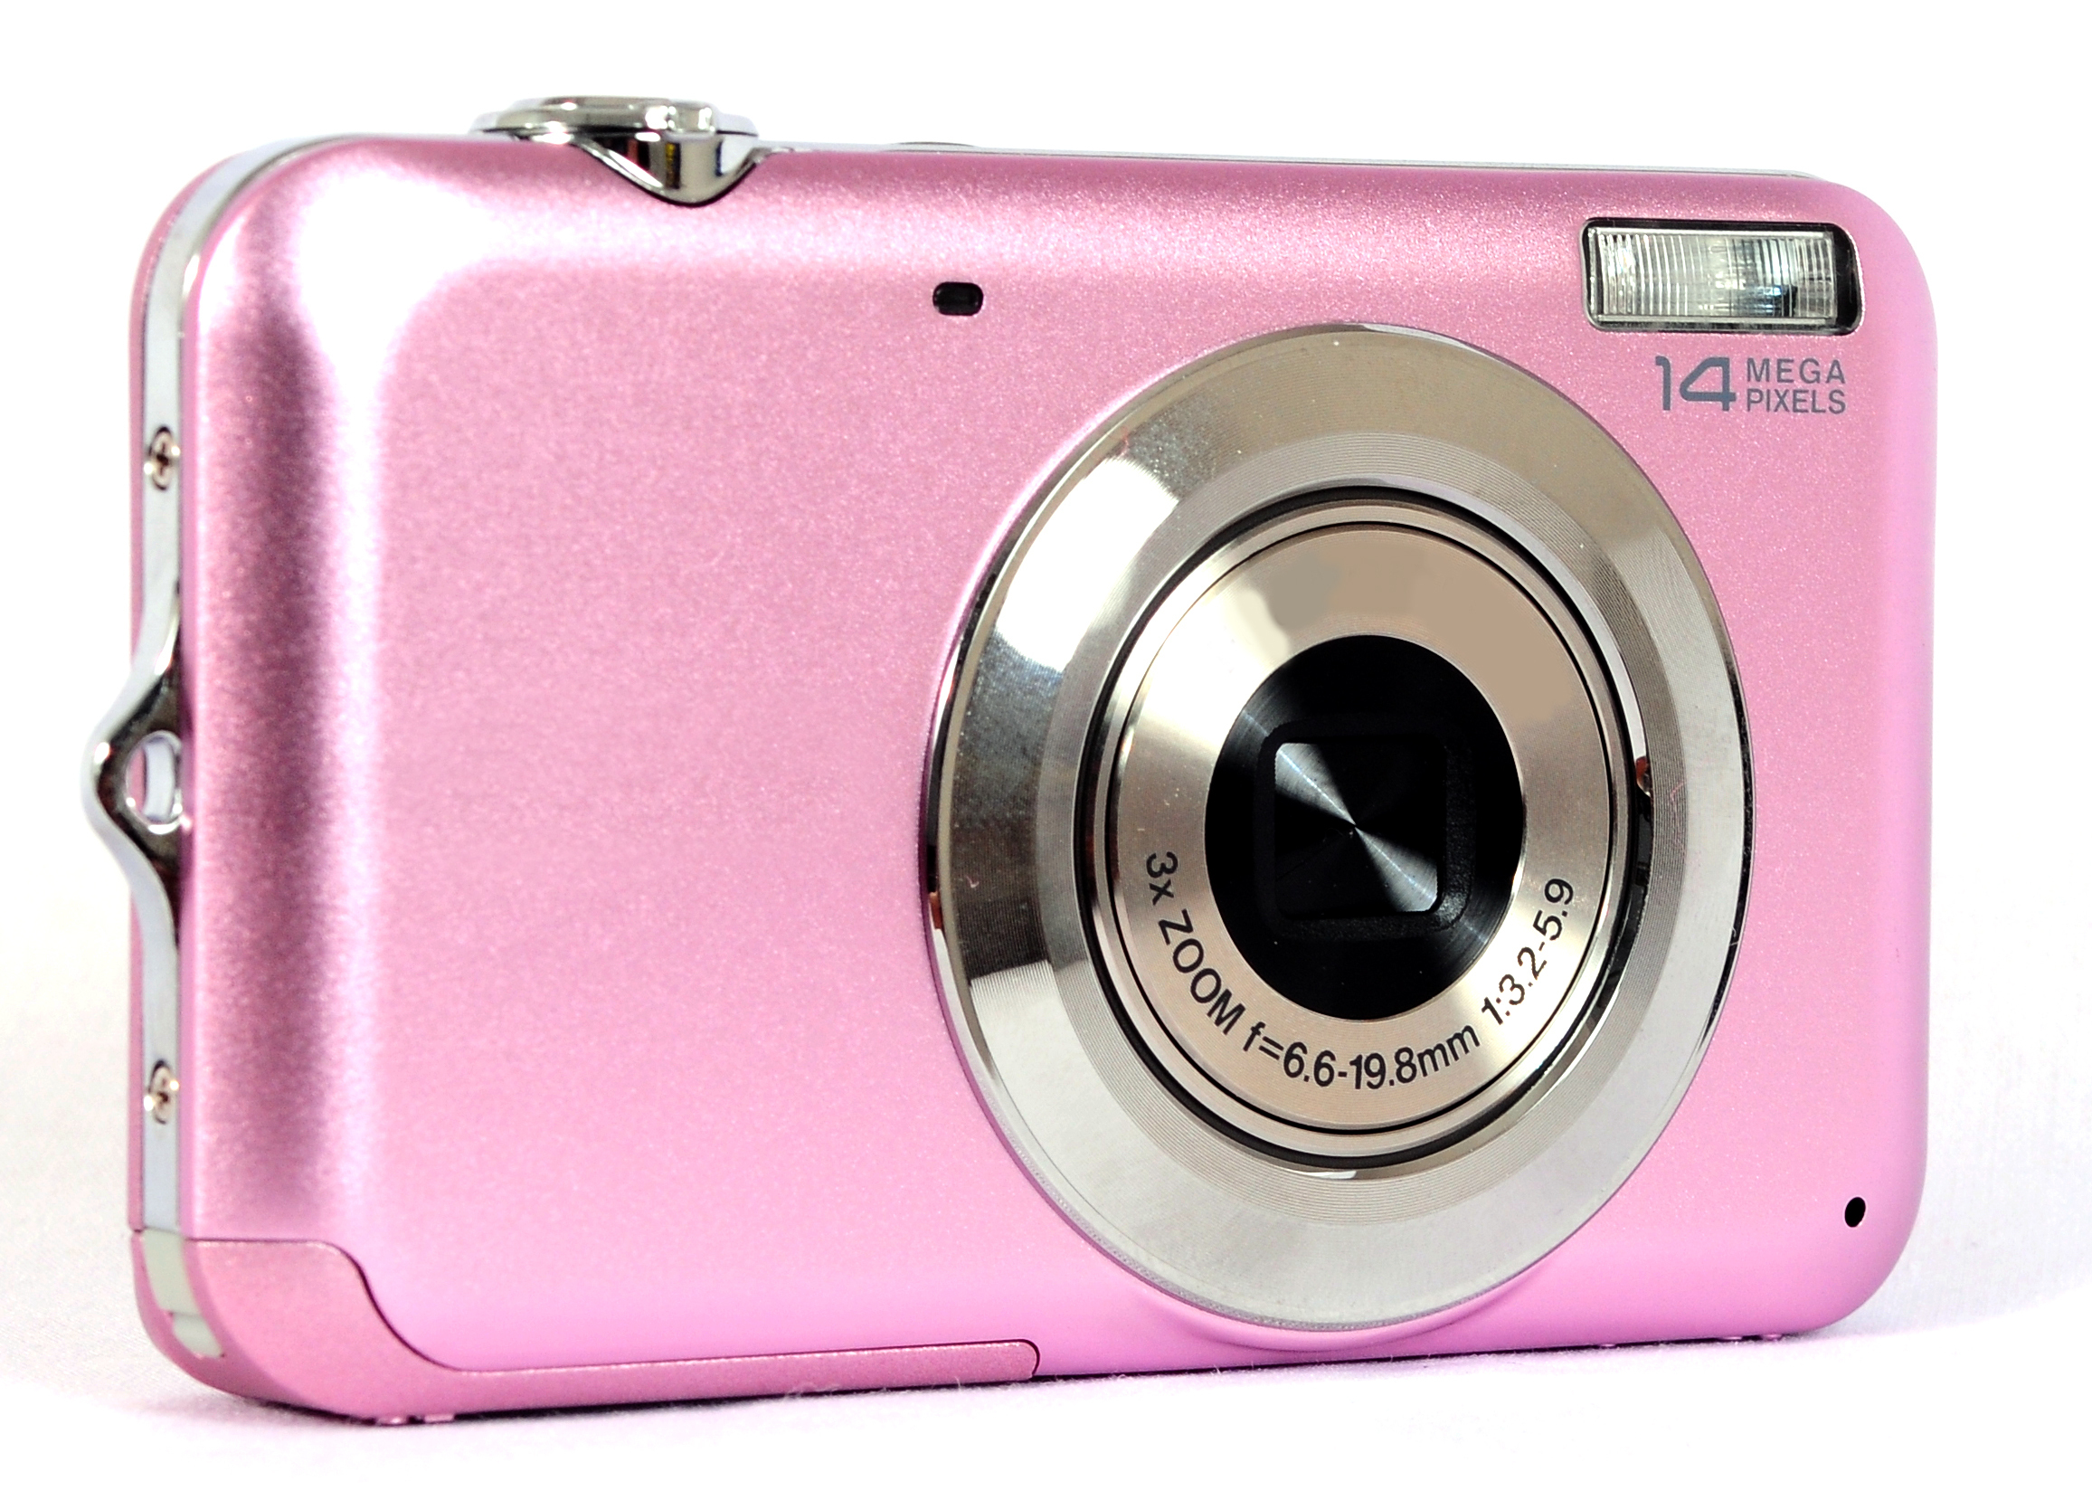
Spot the Tech!
Notes:
Instructional Notes:
Invite students to take a moment to study the images shown on the screen in light of what they just learned about technology.
Ask 1–2 volunteers to suggest which, if any, images should be removed because they are not technology.
Explain to the class that based on the definitions they learned, every picture on this page is technology because all were invented to solve a problem and used knowledge for a purpose.
Click to arrange the images into one timeline for each piece of technology. This is called “technological innovation,” or the changing of things for the better.
Ask students which piece of technology is missing. Give them the hint that it is also the only piece of technology on the screen that could be the last item in each timeline.

Slide 5

Digital Convergence
Digital Convergence:
When multiple functions come together in a single technological device.
Notes:
Instructional Notes:
Remind students that the smartphone can act as a radio, a computer, and a camera. Most can perform many more functions.
Ask students to shout out various functions of smartphones. Record original ideas as you hear them on the board or directly on the slide.
Click to display definition. Explain to students that when multiple functions come together in a single technological device, we call that “digital convergence.”

Slide 6
Ask Questions — Find Answers
Type questions here...
Type answers here...
Notes:
Instructional Notes:
Remind students that inventions and innovations in technology would never happen if there weren’t scientists, engineers, inventors, and regular people asking, “How can I make this better?”
Invite students to turn to a partner and brainstorm additional questions they have about the definition of technology. What ideas do they have for technological innovations? What technologies do they know and how could those technologies be made even better? Give them approximately 5 minutes to complete the task.
At the end of 5 minutes, invite 3–4 volunteers to share their questions. Record them on the slide under “Ask Questions.”
Direct students to spend 3–4 more minutes brainstorming with their partners how or where they might find answers to their questions. Again, invite 3–4 volunteers to share their responses. Record them on the slide under “Find Answers.”
Reinforce that scientists and engineers are constantly asking questions and seeking out resources to find answers.

Slide 7
Binary Code
1
010011101010001000111101000011010111001001010001001110101000100011
2
Signals from one device:
Voice
Video
Music
Text
Reassembled signal on a second device:
Voice
Video
Music
Text
Notes:
Instructional Notes:
Begin session by reinforcing what students learned about technology, innovation, and digital convergence in the previous session.
Ask students to comment on the Binary Code example they see on the screen. Does the Bi- in the word Binary give students a clue as to why they only see two digits—0 and 1?
Invite students to consider what would happen if our smart phone spoke Spanish but the camera spoke Chinese and our credit card spoke Arabic, but our music player spoke French. Would they be able to understand what the others were saying? Ask students, “How could you improve their ability to communicate with one another?”
Invite volunteers to explain to the class how computers and other digital devices communicate with one another. If no one can provide the correct answer, point again to “Binary Code” on the screen. Lead students to the understanding that Binary Code acts as a “translator.” It is a common digital language that allows the functions of a single device or multiple devices to converge and communicate.
Click to show how binary code works. Signals from one device are translated into a series of zeros and ones. The series is sent to another device, which reassembles the zeros and ones into the original signal.

Slide 8
What’s Your Favorite Food?
Binary Code
A 01000001 | J 01001010 | S 01010011
B 01000010 | K 01001011 | T 01010100
C 01000011 | L 01001100 | U 01010101
D 01000100 | M 01001101 | V 01010110
E 01000101 | N 01001110 | W 01010111
F 01000110 | O 01001111 | X 01011000
G 01000111 | P 01010000 | Y 01011001
H 01001000 | Q 01010001 | Z 01011010
I 01001001 | R 01010010
Notes:
Instructional Notes:
Ask students to think silently about their favorite foods and choose one. Tell them the only condition is that it must have between three and seven letters when you spell it out.
Click to reveal the binary code alphabet.
Challenge students to write their favorite food in binary code, stacking the series of binary code “letters” into a column, similar to how the code was displayed in the box in the previous slide.
After approximately 4–5 minutes, have students exchange papers with a peer to see if they can “reassemble the signal” to determine their partner’s favorite food.

Slide 9
Crack the Code!
Part 1
Part 2
1 | 1 | 1 | 1 | 1
0 | 1 | 1 | 1 | 0
0 | 0 | 1 | 0 | 0
0 | 1 | 1 | 1 | 0
1 | 1 | 1 | 1 | 1
Notes:
Instructional Notes:
Provide students with an opportunity to demonstrate their understanding of how binary code disassembles and reassembles signals using the Crack the Code student handout.
Direct students to begin with Part 1. Each box includes a pixelated image of empty and filled-in squares. Reinforce the directions that each empty square stands for a 0 and each filled square represents a 1. Instruct students to record the binary code for each image on the lines next to each box.
Now in Part 2, students will use the right column to practice reassembling messages. They will look at the binary code that is present on each line and fill in the squares accordingly to create their own pixelated images.
Using the answer key as reference, inform each student if they were able to “crack the code.”

Slide 10

Security Engineer
Predict and solve problems before they happen
Design systems that can prevent problems from happening
Keep company’s computer systems safe and working
Design computer systems that are prepared for “disruptions” like natural disasters, cybercrimes, and hacking
Notes:
Instructional Notes:
Reinforce that, during this final session, students will use what they have learned so far to take on the role of security engineers.
Click to reveal and review the main responsibilities of a security engineer.

Slide 11
Cyber Disruptions
Cybercrime:
Any crime that involves a computer and a network or the Internet.
Malicious hacking:
Trying to get into a network, computer, or device without permission.
Notes:
Instructional Notes:
Explain to students that cybercrimes and hacking are the two cyber “disruptions” that they will be focusing on today in their role as security engineers.
Click to reveal and review the definition of “cybercrime.”
Click again to reveal and review the definition of “malicious hacking.”
Ask students if any of them can think of any examples of cybercrime or malicious hacking they have heard of in the news or read about on the Internet. If students cannot come up with examples on their own, offer a few of the more recent and relevant data breach cases from the news.

Slide 12

On the Case!
Our world is using computers for more things every day, and sometimes events happen that cause people not to be able to use them—such as cybercrime or malicious hacking. Security engineers design computer systems that are ready for when these disruptions happen.
You will be Security engineers when a malicious hacker disconnects networks and communication devices at your school. Can you use binary code to communicate with each other, figure out the hacker’s password, and get the network back online?
Notes:
Instructional Notes:
Tell students that today they will take on the role of security engineers in order to solve a case of malicious hacking at their school.
Click to reveal the scenario and read it aloud to the class.

Slide 13

Binary Communication
Short flash represents “0”
Long hold flash represents “1”
Notes:
Instructional Notes:
Split the class into six to eight even groups and pair them up.
Note: The important element is that there is an even number of groups. Each class will be unique depending on class size and classroom management style. Ideally, the groups will be small enough for each student to remain engaged.
Each group should have a Binary Communication Sheet and a flashlight. Make sure half of the groups have Binary Communication Sheet A and their partner groups have Binary Communication Sheet B. Explain that they will be using the flashlights to translate their messages into binary code. Similar to Morse code, a short flash represents a “0” and a long hold flash represents a “1.”
Click once to show the Morse code dot. Demonstrate with a flashlight how a short flash would look and emphasize that represents a “0.”
Click again to show the Morse code dash. Demonstrate with a flashlight how a long hold flash would look and emphasize that represents a “1.”
Give students 1–2 minutes to practice shining “0s” and “1s” within their groups.

Slide 14
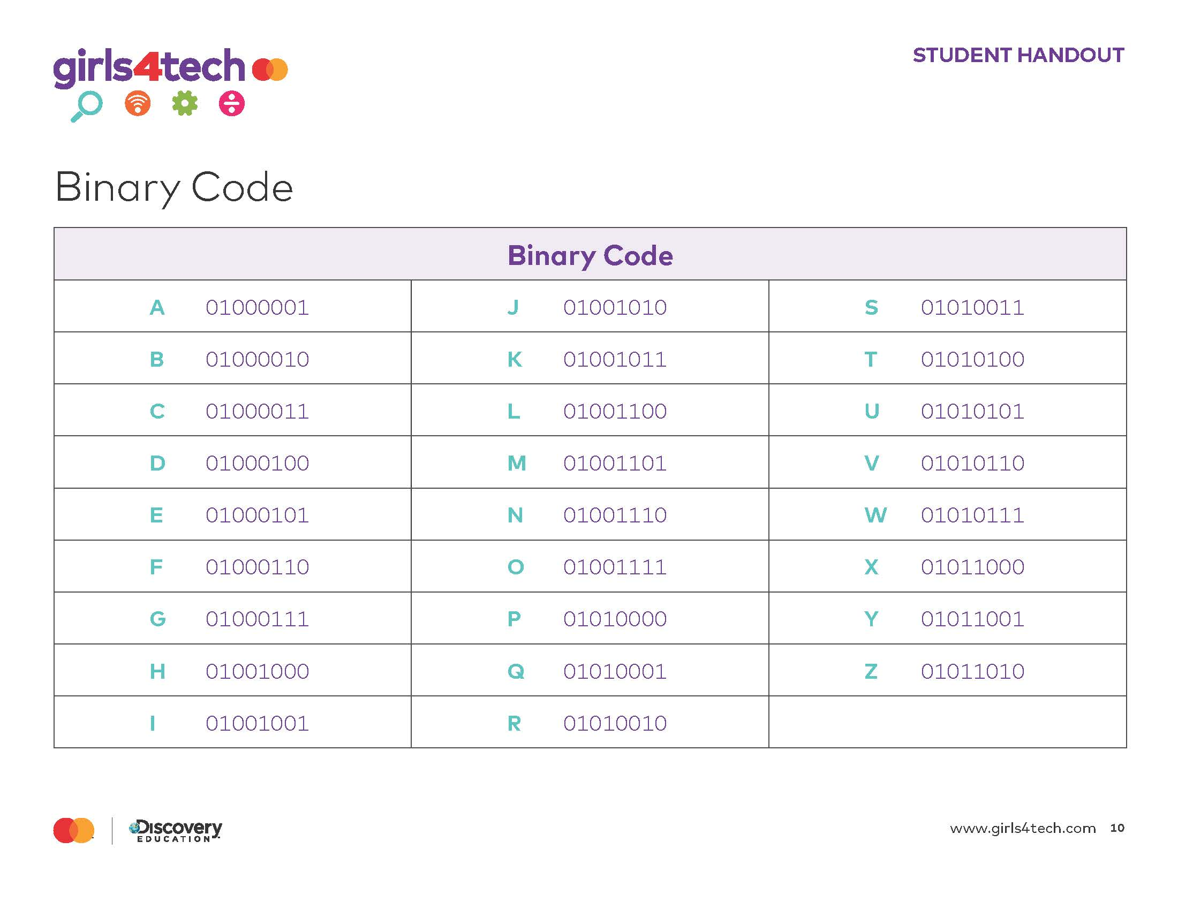
Step 1: Translate Your Messages
With your group, use the Binary Alphabet sheet to translate each message you need to send into binary code.
Notes:
Instructional Notes:
Distribute one Binary Alphabet handout to each student if you have not already done so.
Instruct groups to use their Binary Alphabet handouts to translate the messages they need to send into binary code. Use the Binary Communication answer key to assist as needed.
To keep all students engaged, you may choose to suggest rotating recorders as all students work to decode.

Slide 15
Step 2: Send and Reassemble Messages
Short flash represents “0”
Long hold flash represents “1”
Notes:
Instructional Notes:
Using the flashlight slide as reference, remind students how to communicate each digit of their binary code messages.
Teams should take turns sending messages to their partner groups in order. As one group is using the flashlight, the other group should be recording each transmission as a “0” or a “1.” To keep all students engaged, you may choose to suggest rotating the roles of flashlight flasher, recorder, decoders, etc.
After each transmission has been sent, give the receiving team time to reassemble the signal into a message. Once they have figured out the incoming message, students in that group should use their flashlight to send the next message to their partner team.
This process should repeat until all six messages have been sent and received. Use the Binary Communication answer key to assist as needed.
Optional: Some students respond well and remain more engaged when a competition element is added. One suggestion might be to propose to students that the first pair of groups to correctly communicate all messages will be those that get the network back on and receive bonuses in their roles as Security Engineers.

Slide 16
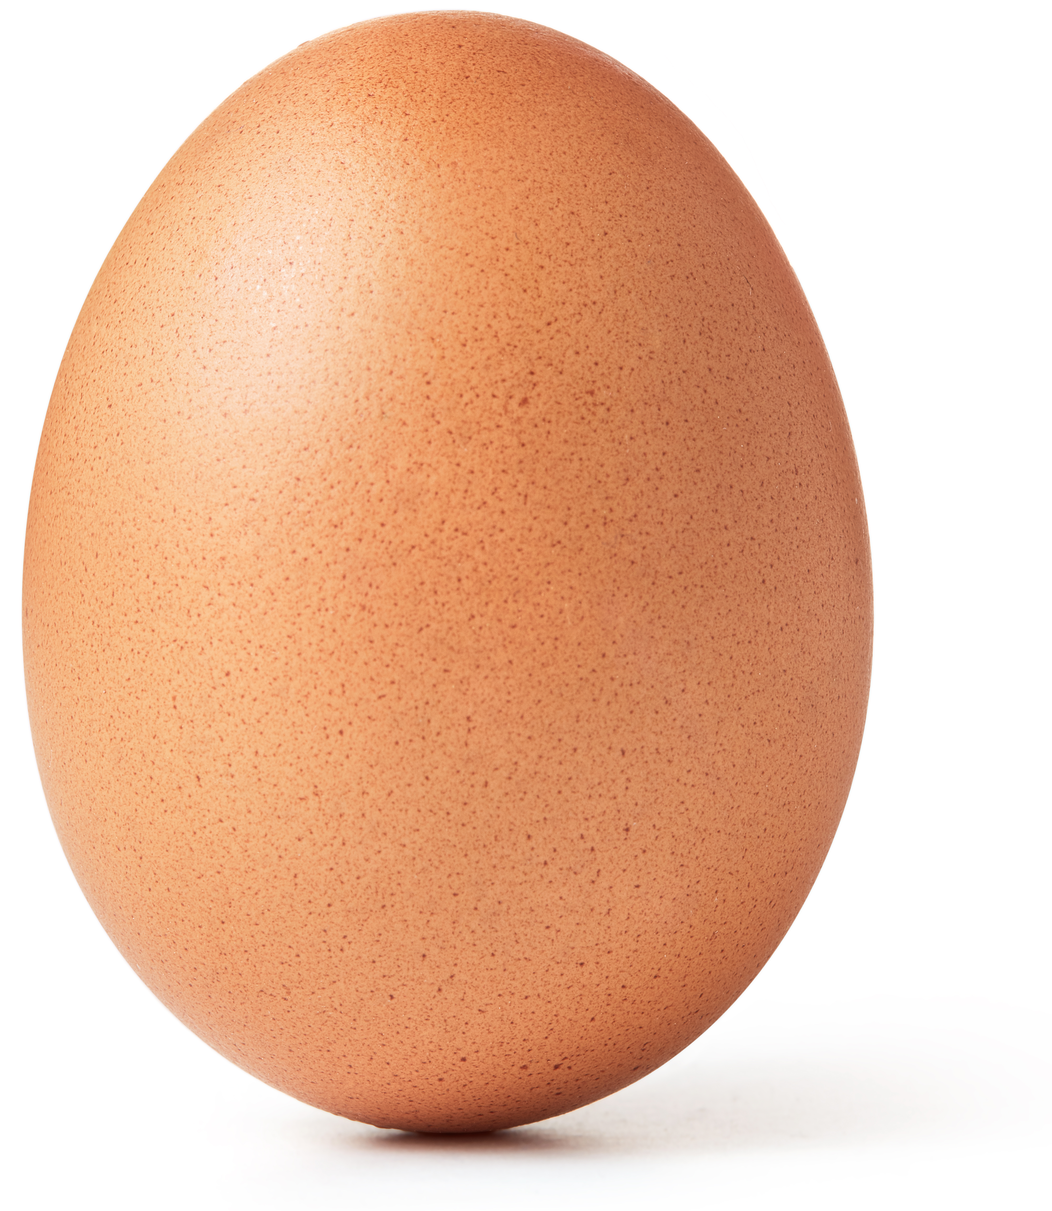
Crack the Code!
What was the hacker’s password?
Notes:
Instructional Notes:
Congratulate all of your security engineers on “cracking the code” and outsmarting the hacker with their knowledge of binary code.
Tell them that at the count of three, you want them all to shout out the hackers’ password. Say, “1, 2, 3.”
As the students all shout, “egg,” click to show the image of an egg.

Slide 17
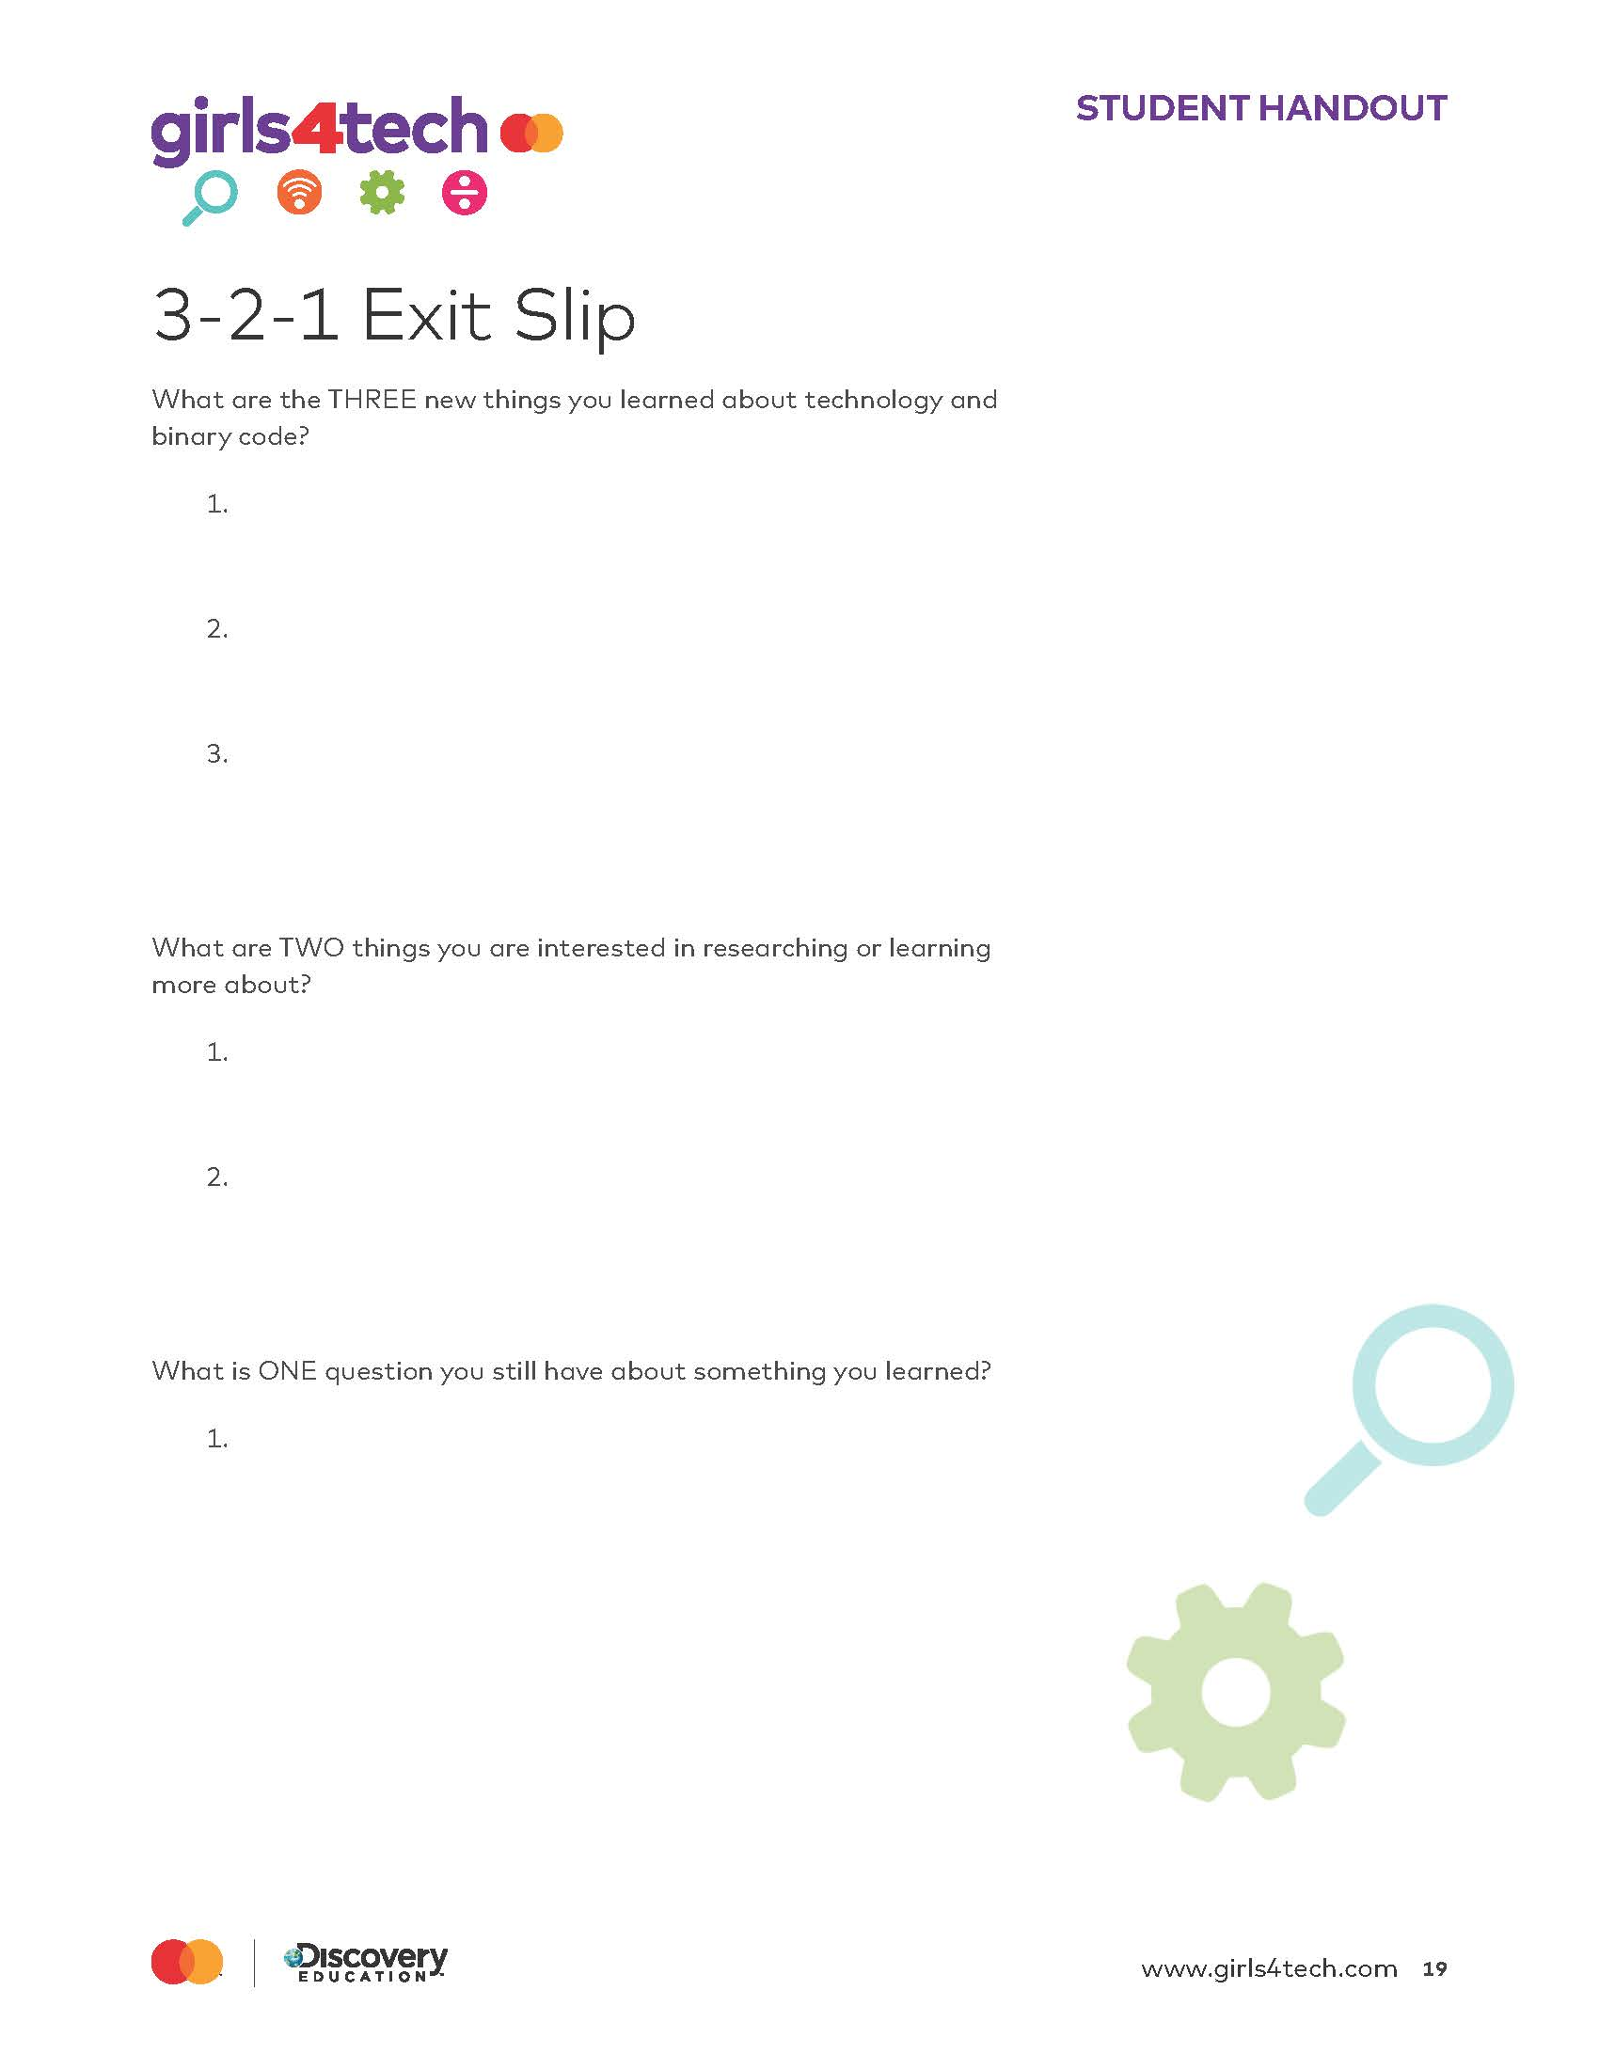
3-2-1 Exit Slip
Notes:
Instructor Notes:
Distribute one 3-2-1 Exit Slip handout to each student.
Collect slips from students. If time allows, choose a few questions that remain and discuss with the group. As you are able, follow up with students regarding their exit slips after the conclusion of the series.

